Slide 1
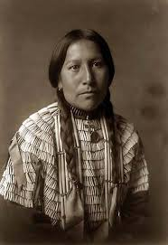
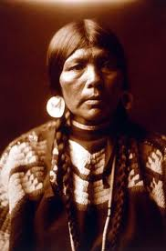
Managing Your New Tribal Governments Program Award
Presented by the
James A. Smith,
OVW Grant Program Manager
2019 Coordinated Tribal Assistance Solicitation (CTAS) Orientation
Hyatt Regency Tamaya Resort on the Santa Ana Pueblo
December 3, 2019

Slide 2
Purpose of the Presentation
The purpose of this presentation is to provide grantees with information about OVW’s Tribal Governments Program (TGP) under CTAS, its requirements, and tips on how to manage your new grant award.

Slide 3
Department of Justice – Office on Violence Against Women
The mission of the Office on Violence Against Women is to provide federal leadership in developing the nation’s capacity to reduce violence against women and administer justice for and strengthen services to victims of domestic violence, dating violence, sexual assault, stalking and sex trafficking.

Slide 4
OVW Tribal Affairs Division Staff
Sherriann Moore, Deputy Director for Tribal Affairs
Darla Sims, Grant Manager Team Lead
Rebekah Jones, Grant Program Specialist
Tia Farmer, Grant Program Specialist
James A. Smith, Grant Program Specialist

Slide 5
FY 2019 Tribal Governments Program (PA #5)
Tribal Governments Program is the source of funding for all awards under PA #5
Recipients bound by all of the statutory requirements of the Tribal Governments Program
There are no CTAS-specific requirements

Slide 6
What is CTAS?
CTAS is not a program but is the overarching structure, under which tribes can apply up to TEN separate grant programs through one single application!

Slide 7
The TGP…
Since its inception has funded hundreds of projects for tribes and Alaska Native Villages
Is the largest federal grant program providing funding to federally recognized tribes and tribal organizations to address violence against Indian Women within the Tribal Affairs Division

Slide 8
The TGP…
Consolidates tribal funding from five OVW grant programs :
1. Legal Assistance for Victims
2. Improving Criminal Justice Responses (formerly the Arrest program)
3. Rural
4. Transitional Housing
5. Justice for Families

Slide 9
It’s important to note…
TGP does not mirror the five programs
Some of the activities considered allowable under the other grant programs are not allowable in TGP
TGP awards are not subject to all of the special conditions, restrictions, limitations and polices as the other programs

Slide 10
TGP… Cont’d
Is a discretionary grant program
Like all grant programs, has a number of special conditions, restrictions, limitations and polices.

Slide 11
General OVW Grant Program Requirements
OVW and the grantee agree on the specific activities that will be supported with grant funds
OVW and the grantee agree on a detailed, itemized budget
OVW and the grantee discuss any changes to the activities or the budget before they are made
Semi-annual Progress Reports & Quarterly Financial Status Reports
Comply with all special conditions
Activities and costs supported with award funds should be limited to those that are in the approved proposal
New activities must fall within the statutory program purpose areas

Slide 12
Tribal Governments Program Specific Requirements
Maintain Collaborative Partnership – Indian Victim Service Organization, Tribal Coalition, Advisory Group
Legal Services Certification
Transitional Housing Policies & Procedures
BIP must use the coercive power of CJ system

Slide 13
Special Conditions (SCs)
Purpose: Help to define how the funds can be used & to determine what your obligations are as a grantee
There are a minimum of 42 OVW SCs
Agreed to comply with them as part of accepting the award

Slide 14
Unallowable Activities
Prohibited by Federal laws, rules, policies or regulations
Fundraising
Research Projects
Making physical modifications to a building, including minor renovations
Notes:
Unallowable Activities include but are not limited to these activities.

Slide 15
Victim Safety Issues
Ordering Victims and offenders to attend mandatory couples counseling or mediation
Diversion Program
Batterer Intervention Programs not court-ordered and court-monitored

Slide 16
Victim Safety Issues Cont’d
Anger Management classes instead of Batterer Intervention Programs
Using practices that fail to protect the confidentiality of victims
Referring victims to Child Protection Services solely for failure to protect their minor child from witnessing DV

Slide 17
Grant Monitoring
OVW monitors grantee activities by the following means:
Desk Reviews or OBRS
Site Visits
Review of Progress Reports, Financial Status Reports, and Payment History Reports

Slide 18
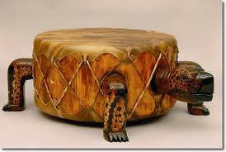
PRIOR APPROVAL
You must obtain prior approval from OVW before:
Adding or removing activities;
Adding or removing staff positions;
Creating new line items in your budget;
Using your OVW Travel set-aside funds to attend non-OVW sponsored training and technical assistance events; and
Changing your collaborative partner
Notes:
GFMD will review the requirements for making changes to the budget, our presentation will focus on making programmatic changes

Slide 19
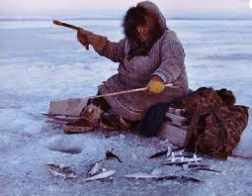
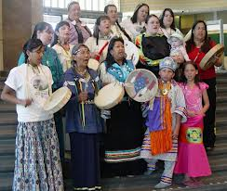
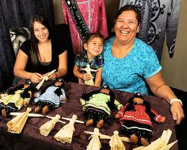
Prior Approval Cont’d
Compensating a consultant at a rate that exceeds $650/day or $81.25/hour
Publishing/distributing products that are created with grant funds
On-site or local training events paid for with grant funds (i.e., approval of training consultants, subject matter content, handouts, and agenda)
Notes:
The numbers of the SCs associated with these SCs might vary. However, these SCs are noted in your award package. Include OVW’s disclaimer ion publications and materials created with grant funds.

Slide 20
How to Obtain Prior Approval to Attend a Non-OVW Sponsored Training Event
Submit a Program Office Approval Grant Adjustment Notice (GAN) in Grant Management System (GMS)
Provide the name, date(s), and location of event
Provide the total amount of unobligated OVW travel funds for the award
Provide the total estimated cost of attendance/participant
Justify the request by stating how attending the event relates to the goals and objectives of the grant-funded project
Requests must be submitted at least 20 business days before the start of the event
Wait for approval of the GAN before obligating any funds
OVW will not approve travel to events that cover subject matter/issues that cannot be addressed with grant funds

Slide 21
7 Helpful Tips for Grantees

Slide 22
TIP #1 Submit Reports Prior to the Due Date
Programmatic Progress Reports
Reporting Period | Due Date
January 1- June 30 | July 30th
July 1- December 31 | January 30th
Financial Progress Reports
Reporting Period | Due Date
January 1- March 31 | April 30th
April 1- June 30 | July 30
July 1- September 30 | October 30
October 1- December 31 | January 30
Notes:
These dates are not flexible. If the report is not submitted in GMS on the 31st day, the system will automatically freeze the funds and they will remain frozen until the over-due report has been submitted.
Timely submission of reports – both programmatic and financial – is important!! A history of late reporting can effect future funding decisions.

Slide 23
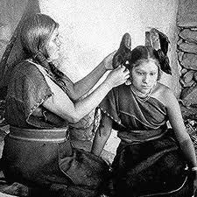
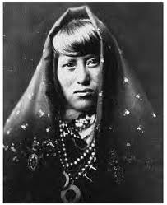
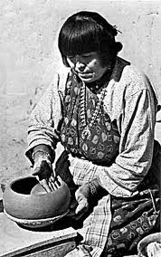
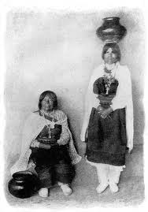
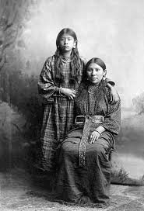
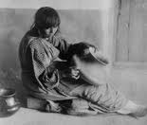
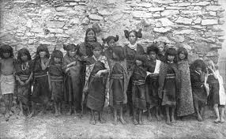
TIP #2 Communication is Key
Keep your POC information in GMS up-to-date to assure you notices on: Delinquent Reports, Frozen Funds, Close-out Reminders, and other important correspondence.
Notes:
POC means Point of Contact, this should be mentioned to grantees.

Slide 24
Tip#2 Communication Cont’d
Make sure that the Project Director and other key staff and project partners have a copy of the approved application
Read your special conditions and ask questions! Make sure your project partners understand your special conditions as well
Talk to your Grant Program Specialist –
Before making changes to your project/budget
But also to share and celebrate your successes and talk through challenges

Slide 25
TIP #3 Help is just a phone call or mouse click away
OVW Grants Financial Management Division (GFMD):
1-888-514-8556
OVW.GFMD@usdoj.gov
GFMD is staffed with financial analysts who can answer general financial questions regarding the use of federal funds based on guiding federal regulations.
OVW Grants Management System (GMS) Technical Support:
1-866-655-4482
OVW.GMSSupport@usdoj.gov
OVW GMS Technical Support provides assistance with navigating the GMS system, problem solving technical challenges, and troubleshooting issues with GMS.
Notes:
Know who to call for what

Slide 26
Tip #3 Cont’d
Muskie School of Public Service
1-800-922-VAWA (8292)
vawamei@usm.maine.edu
http://muskie.usm.maine.edu/vawamei
Muskie supports OVW by developing and instructing grantees how to complete the
semi-annual progress reports. This team provides webinars, instructions, and technical assistance to grantees regarding the data that is included in these reports.

Slide 27
Tip #3 Cont’d
Grants Payment Request System (GPRS) Guide
http://www.ojp.gov/about/pdfs/gprsuserguide.pdf
This guide provides grantees with a basic understanding of how to navigate the request system and draw down grant funding.
Federal Audit Clearinghouse
https://harvester.census.gov/facweb/
Information about the requirements for submitting federal audits as well as a detailed history of grantee’s audit submissions.

Slide 28
TIP #4. Technical Assistance
Support for OVW grant program implementation
Support for grantee project implementation
Opportunities to learn from experienced experts
Tailored assistance to meet the specific needs for your organization
May be recommended by OVW
Notes:
Why TA? The Tribal Governments Program has a number of TA providers. Advise them to visit the tables of the TA providers to learn more about their programs and how they can assist them with their programs.

Slide 29
TIP #5 Grant File and Documentation
Hard Copies of all official correspondence
Hard Copies of documents that demonstrate approval, which may include e-mails
All GANs
Financial records
Copy of fiscal year solicitation
Copy of approved application and approved revisions
Signature documents
Notes:
Files should be complete and stored 3 years pass the office close out date

Slide 30
TIP #6 Project Changes
Must consider the approved project activities, program scope and purpose
Must work with and receive approval from OVW Grant Manager
Comply with the OVW/OJP/DOJ Financial Grants Management Guide (budget considerations)
GANs are not officially processed until an approved GAN is posted on GMS (change requested)
Notes:
Financial Guide even if you are only responsible for the program aspect of the grant.

Slide 31
Tip # 6 Project Changes Cont’d
Project period adjustments
Program scope change
Retirement of special conditions
Budget modifications
Key staff changes
Contact information for the POC and Authorized Representative should be kept current

Slide 32
Tip #7 – Keep the Vision
Notes:
We know you are just starting your award, but be thinking about building capacity for the future of your program and your tribal nation.
Relationships are important - Engage your community, local internal and external partners, and survivors - Network with other tribal service providers - Maximize the benefit of TA including Tribal Coalitions in your area by building a relationship with them they are experts than can help – call your Grant Program Specialist

Slide 33
Congratulations on Receiving your New Tribal Governments Program Award!
*Stay in touch with your Grant Program Specialist!

