Slide 1
Crime Victim Rights & Enforcement
Wisconsin Department of Justice
Office of Crime Victim Services
Victim Resource Center

Slide 2
Overview
Victim Rights
Enforcement
Resources &
Contact Information

Slide 3
Office of Crime Victim Services
Grants
CVC
VRC
Safe at Home
Training & Policy

Slide 4
Victim Resource Center (VRC)
Informal Victim Rights Complaint Process
Victim / Witness Services
Training & TA for V/W staff
General Victim Assistance
Victim Appellate Notification Services
Crisis Response

Slide 5
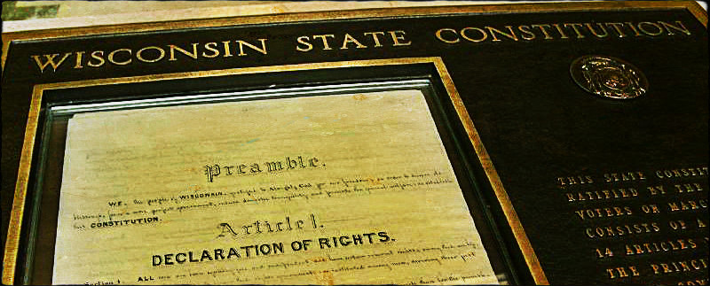
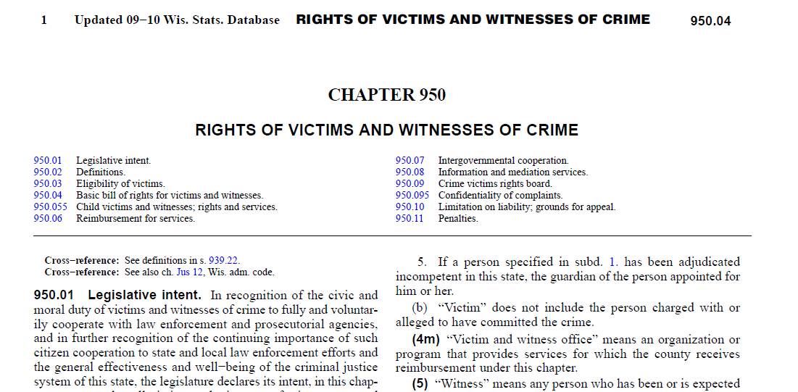
Victim Rights Authority

Slide 6
History of Victim Rights in WI
Milwaukee V/W Program created
Rights & services expanded for victims of juvenile crime
“Enabling” legislation creates CVRB
1999 – CVRB receives first complaint
WI becomes first state to pass bill of rights
84% of WI voters ratify amending WI Constitution to include rights for crime victims
1998
1996
1993
1980
1975

Slide 7
Who is a victim?
Statutory Definition
Victims unable to exercise rights
Minor victims
Deceased victims
Can change from LE determination to prosecution!
Different than CVC definition!

Slide 8
Who is NOT a victim?
Not a Victim

Slide 9
Exercising victim rights
does NOT require cooperation with LE or prosecution

Slide 10
POP
QUIZ!

Slide 11
Defendants’ Rights

Slide 12
Name that victim right!

Slide 13
Name that victim right!

Slide 14
Name that victim right!

Slide 15
Name that victim right!

Slide 16
Name that victim right!

Slide 17
Name that victim right!

Slide 18
Who is responsible for providing rights?
Prosecutor
Law Enforcement
Summary of prosecution
procedure
Procedure for
addressing threats/intimidation
Written notification of rights
Custodial
Information
Contact info for participating in process
Availability of CVC
Contact info
including advocacy

Slide 19
Victim accompaniment
Speedy disposition
No lie detector
Property return
Right to notice of & to attend proceedings
Victim accompaniment
Speedy disposition
Confer
Request HIV/STD testing
Employer intercession assistance
Exclusion from trial
Victim impact statement
Restitution
PSI
Notice of releases, escapes, confinements
Notice of discharge
Victim accompaniment
Fairness, dignity, and respect for privacy

Slide 20
Enforcement
Informal Complaint Process
DOJ Victim Rights Specialist
Formal Complaint Process
Crime Victims’ Rights Board

Slide 21
Informal Complaint Process
Not a finder of fact – does not investigate!
Victim led
Gathers information
Closing letter
Limits to confidentiality

Slide 22
Formal Complaint Process
Victims must complete informal process first
Crime Victims’ Rights Board (CVRB)
Can conduct investigations
Can make determinations of violations
Determines remedies
Attached to DOJ for admin purposes only

Slide 23
Resources & Referrals
1-800-446-6564
Stephanie Mock
Victim Rights Specialist
608-267-2236
Anne Kessenich
Victim Rights Specialist
608-261-7194
Hannah Wrobel
Victim Services Specialist / VANS
608-267-5249
Betsy Mardany
Victim Services Specialist
608-264-9446

